Slide 1

Where Your
Imagination
Becomes a
Model

Slide 2
Who We Are
We are a Web-based 3D printing & design company
We bring ideas to life with creativity and precision
We offer a remote service with fast communication
We specialize in custom 3D prints from large part molds to simple decorative models

Slide 3
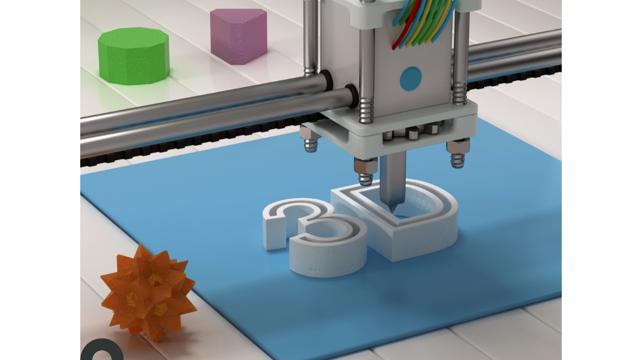
What We Do
Custom 3D Printed Products
Prototype & Concept Design
Decorative & Functional Pieces
Personalized Gifts

Slide 4
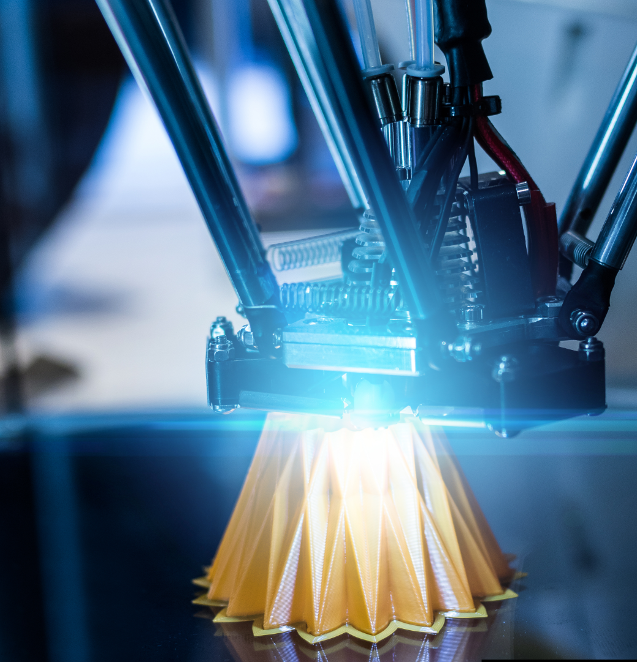
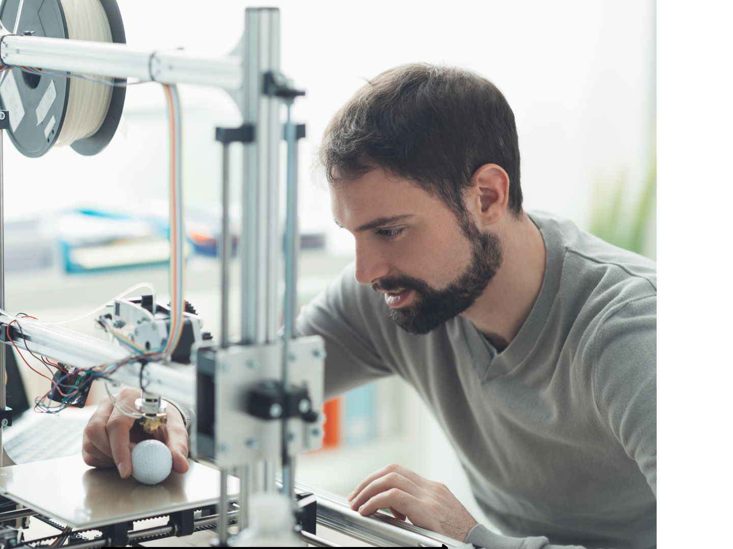
How We Work
Small, dedicated team
Remote service only
24/7 messaging
Support for email & phone calls, available 9 AM – 5 PM
We only ship within the continental US

Slide 5
Meet our Team
Nancy Andersson – PR Associate nancy@smartdesignz.com
Diana Laplante - Presentation Authority diana@smartdesignz.com
Meredith Widdowson - Documentation Specialist meredith@smartdesignz.com
Ryan Wisnyai – Accountant ryan@smartdesignz.com
Zane Hochstetler – Website Development zane@smartdesignz.com
Tristan Stefanides – Website Development tristan@smartdesignz.com

Slide 6

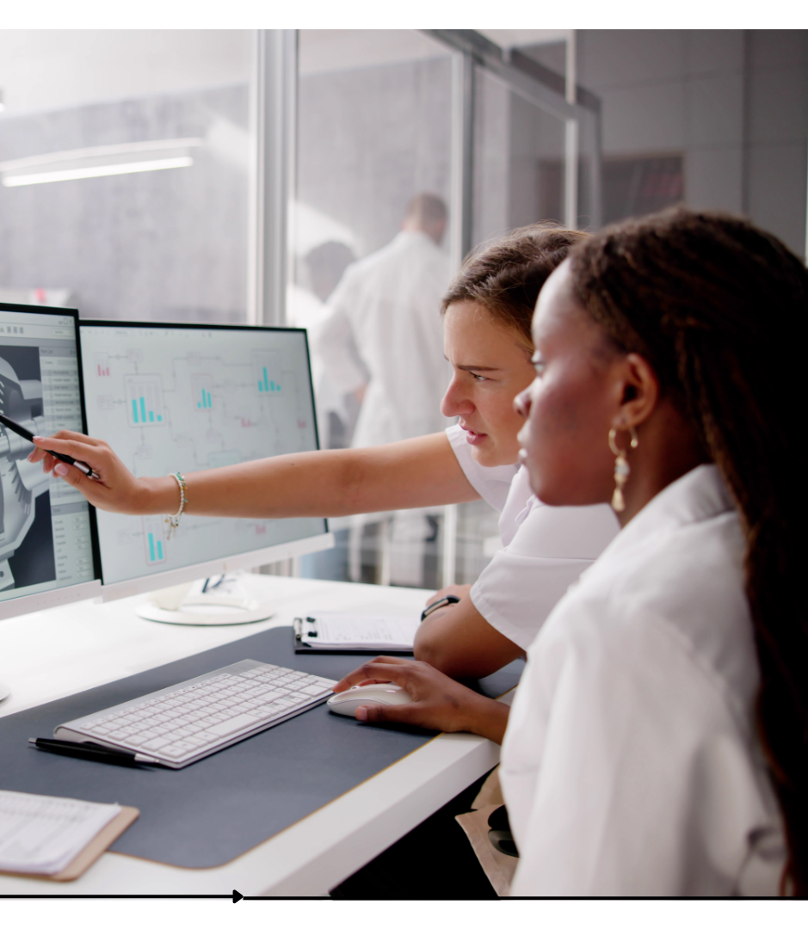
Our Core Values
Quality & Craftsmanship
Fast Turnaround
Customer-Focused Service
Innovation & Creativity

Slide 7
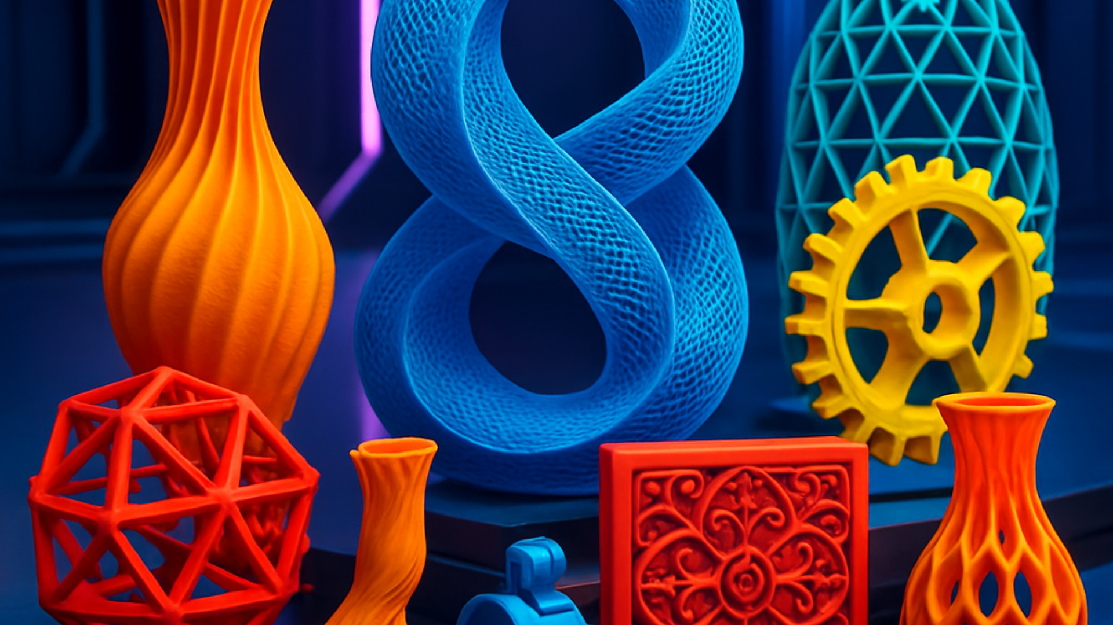
Contact Us
📧 info@smartdesignz
📞 (330) 843-3333
📍 3333 Main Street, Newton Falls, OH 44444
HOME | sMaRT DesigNZ

